Slide 1

Betting just Got easier
Johnson Ngandjui
9.20.21

Slide 2

Agenda
INTRODUCTION
Statistical Information

Slide 3

INTRODUCTION
Data
All game scores of the big five European soccer leagues (England, Germany, Spain, Italy and France) for the 1995/96 to 2019/20 seasons.

Slide 4

Statistical Information
Let’s Dive In

Slide 5
 | Stats about Data
File Type | BIG FIVE 1995-2019.csv
Description | A free open public domain football database & scheme for use in any (programming) language by Kaggle analyze league levels. evolution of game over 5years.
#of Records | 44269
#of Columns | 15
Size | 664035
Column Names | 'Round', 'Date', 'Team 1', 'FT', 'HT', 'Team 2', 'Year', 'Country', 'FT Team 1', 'FT Team 2', 'HT Team 1', 'HT Team 2', 'GGD', 'Team 1 (pts)', 'Team 2 (pts)'
Shape | (44269, 15)
Values | dtype: int64

Slide 6
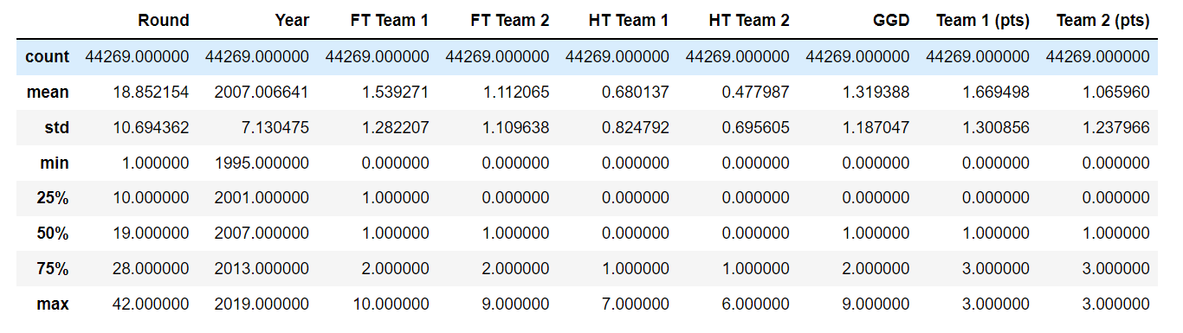
Statistics

Slide 7
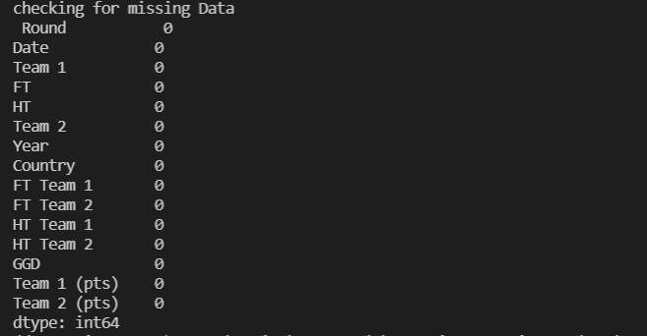
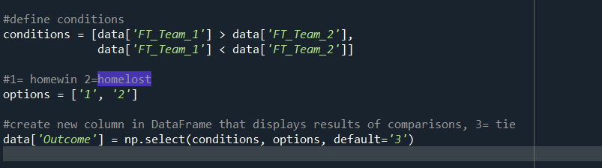
Preprocessing
Checking for missing data.
Added wins, loses, and tie Feature

Slide 8
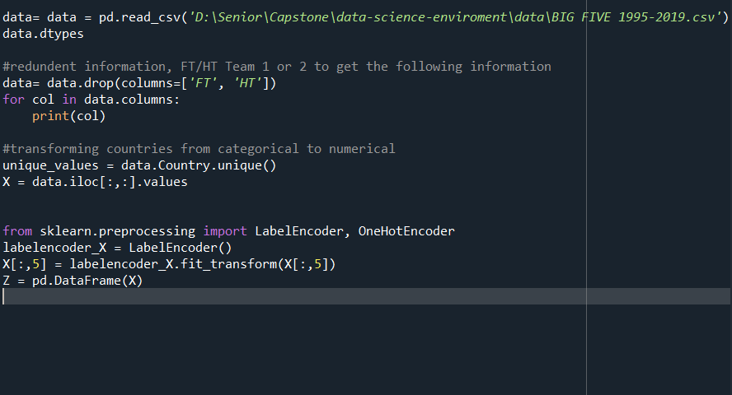
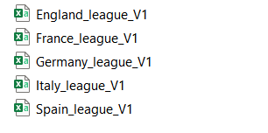
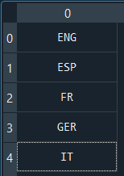
Countries(Label Encoder)
Changed countries integers, represented as 0,1,2,3,4
Created various data frames so I can store each league as its own csv. We can do league comparison.

Slide 9
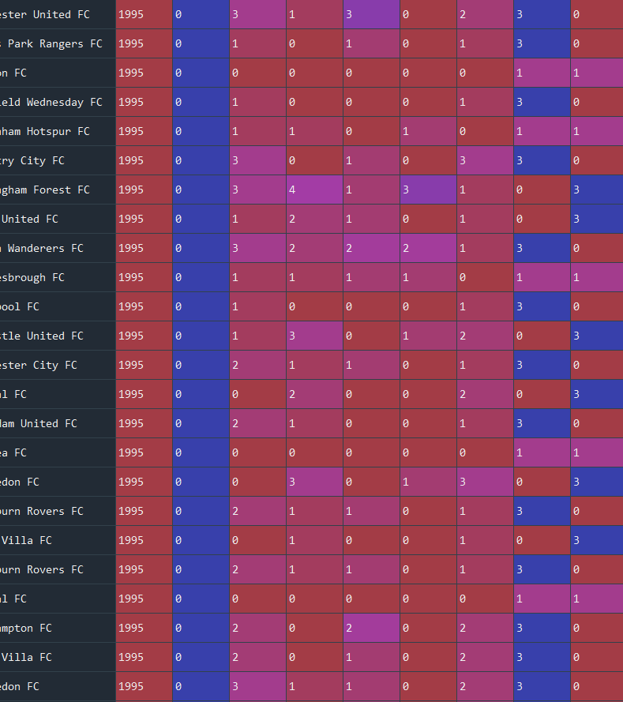
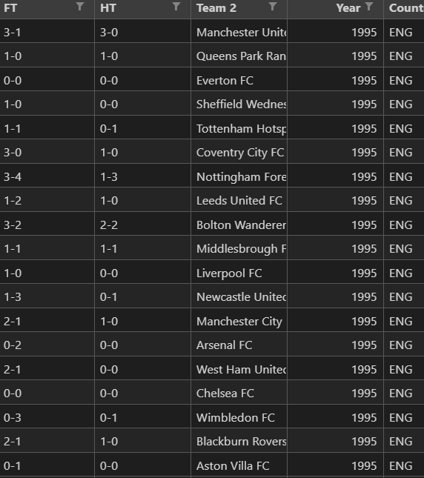

Slide 10
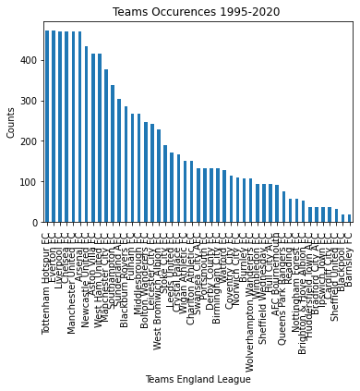
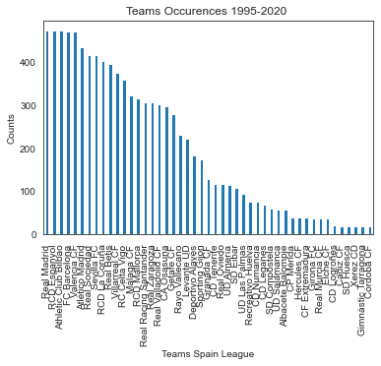
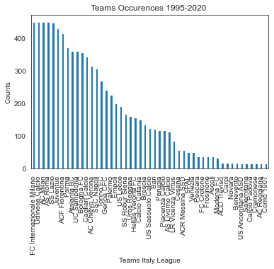
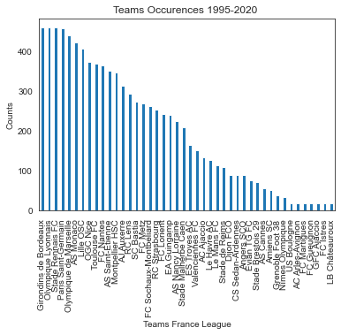
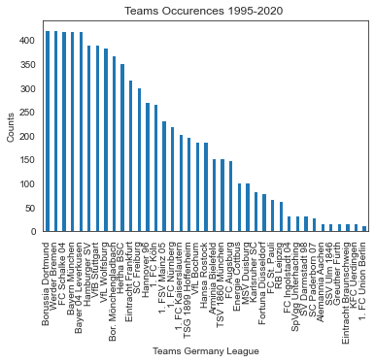
Tottenham Hotspur FC 471
Everton FC 471
Liverpool FC 470
Chelsea FC 470
Manchester United FC 470
Arsenal FC 469
Newcastle United FC 433
Aston Villa FC 414
West Ham United FC 414
Manchester City FC 376
Southampton FC 337
Sunderland AFC 304
Blackburn Rovers FC 285
Fulham FC 266
Middlesbrough FC 266
Bolton Wanderers FC 247
Leicester City FC 242
West Bromwich Albion FC 228
Stoke City FC 190
Leeds United FC 171
Crystal Palace FC 166
Wigan Athletic FC 152
Charlton Athletic FC 152
Swansea City AFC 133
Portsmouth FC 133
Derby County FC 133
Birmingham City FC 133
Watford FC 129
Coventry City FC 114
Norwich City FC 110
Burnley FC 109
Wolverhampton Wanderers FC 109
Wimbledon FC 95
Sheffield Wednesday FC 95
Hull City AFC 95
AFC Bournemouth 91
Queens Park Rangers FC 76
Reading FC 57
Nottingham Forest FC 57
Brighton & Hove Albion FC 53
Huddersfield Town AFC 38
Bradford City AFC 38
Ipswich Town FC 38
Cardiff City FC 38
Sheffield United FC 32
Blackpool FC 19
Barnsley FC 19

Slide 11
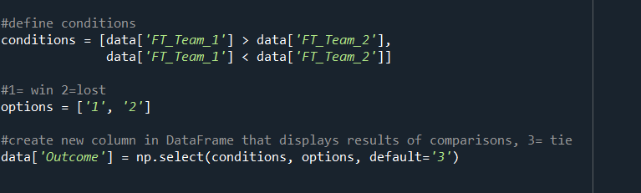
The impact of home field
Bayes Theorem ( the probability of something happening based on prior knowledge)
1 47.777778 Win
3 27.777778 Tie
24.444444 Lost
In the 2019 England football season the 27.777778 % of the matches have been a tie and the 24.444444 % of the matches have been a defeat for the home team.

Slide 12
2019 England 2 goals analysis: why two goals? avg goals score home 1.57 avg goals score away 1.12
home team wins which includes 3 or more goals being scored 1891
total home team wins 4569
In the 41.38761216896476 % of the home victories 3 or more goals have been scored
Draws which includes 3 or more goals being scored 92
total Draw 2422
In the 3.7985136251032205 % of the draws 3 or more goals have been scored
away team wins which includes 3 or more goals being scored 879
total home team wins 2563
In the 34.29574717128365 % of the away victories 3 or more goals have been scored

Slide 13
What is next?
Predicting FTR (full time result)
Multiclass classification problem, this is not just the home team wining or losing, they can win , lose, or draw. Only features that we need. This is something that has been going on forever, espn, bleacherreport and more are constantly trying to predict games. Sports betting to grow at double digits rates over the next five years. Why? (internet access, machine learning is democratize people are able to do it )
The impact of home field
Mathematical optimization /machine learning.
Train 3 classifiers,
data logistic regression- used to describe data and to explain the relationship between one dependent binary variable and one or more nominal
support vector machine-a machine learning model that is able to generalise between two different classes if the set of labelled data is provided in the training set to the algorithm. The main function of the SVM is to check for that hyperplane that is able to distinguish between the two classes.
XGboost- Gradient boosting is a supervised learning algorithm, which attempts to accurately predict a target variable by combining the estimates of a set of simpler, weaker models.
Once the right model is picked, I will optimize that model to predict winning team

Slide 14
Questions
+> Analyse the evolution of football in the 5 major leagues over the last 25 years.
+> Pteams…etc.repare all kinds of dashboards on the games, seasons,
+> Analyze the differences between countries in terms of league level.
+> Identify patterns, schemes in the data…etc.
Most improved teams
How does the period they play in effect win to lost ratio, does a team that win the summer lose in the winter?

Slide 15
THANK YOU

